Slide 1
Gfarm v2 and CSF4
SC08 PRAGMA Presentation at NCHC booth
Nov 19, 2008, Austin
Osamu Tatebe
University of Tsukuba
tatebe@cs.tsukuba.ac.jp
Xiaohui Wei
Jilin University

Slide 2
Motivation
PRAGMA Life Science Group requires worldwide distributed data analysis
  SDSC in US, KISTI in Korea, Academia Sinica in Taiwan, . . .
  Generate simulated data using available compute resources
  Analyze them depending on site-own interests

Slide 3
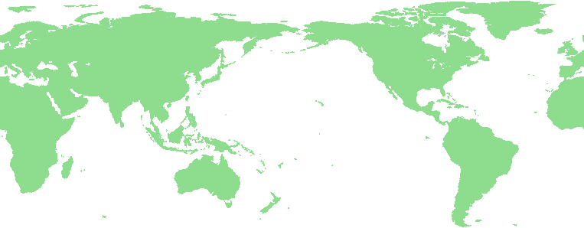
Gfarm v2 and CSF4
Open source project
  Gfarm v2 – worldwide distributed file system
  CSF4 – metascheduler
Metascheduler
Site A
Site B
Worldwide distributed
file system
Job Scheduler
Job Scheduler
File System
File System

Slide 4
Gfarm Grid File System [CCGrid 2002]
Distributed file system that federates storage of each site
It provides scalable I/O performance wrt the number of parallel processes and users
It supports fault tolerance and avoids access concentration by automatic replica selection
It is an open source project hosted by sourceforge.net
Global
namespace
/gfarm
ggf
jp
mapping
aist
gtrc
file1
file2
file1
file2
file3
file4
File replica creation
Gfarm File System

Slide 5
Scalable I/O Performance
Decentralization of disk access putting priority to local disk
  When a new file is created,
    Local disk is selected when there is enough space
    Otherwise, near and the least busy node is selected
  When a file is accessed,
    Local disk is selected if it has one of the file replicas
    Otherwise, near and the least busy node having one of file replicas is selected
File affinity scheduling
  Schedule a process on a node having the specified file
    Improve the opportunity to access local disk

Slide 6
Scalable I/O performance in distributed environment
User’s view
Physical execution view in Gfarm
(file-affinity scheduling)
User A submits that accesses
File A
is executed on a node that has
File A
Job A
Job A
User B submits that accesses
File B
is executed on a node that has
File B
Job B
Job B
Cluster, Grid
network
CPU
CPU
CPU
CPU
Gfarm file system
Shared network file system
File system nodes = compute nodes
Do not separate storage and CPU (SAN not necessary)
Move and execute program instead of moving large-scale data
exploiting local I/O is a key for scalable I/O performance

Slide 7

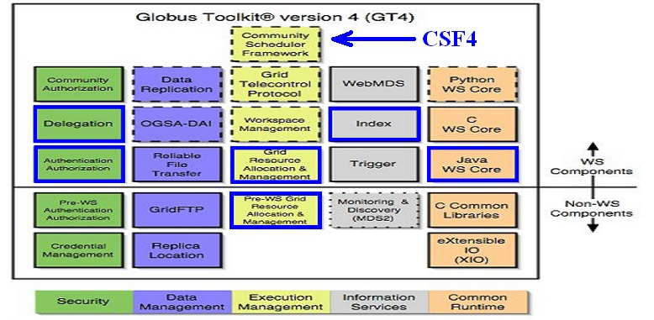
What is CSF4
CSF4 is a WSRF compliant meta-scheduler, its first version was released as an execution management service component of Globus Toolkit 4.(2004)
It is an open source project. (sourceforge.net)

Slide 8
CSF4 Services
CSF4 consists of
  Job Service
    interface for end users to fully control a job
  Reservation Service
    reserve the resources in advance to guarantee the resource availability
  Queuing Service
    represent a specific scheduling policy
Plugin mechanism to easily extend scheduling policy
  FCFS, SJF plugins
  Workflow plugin, data aware plugin
  Array job plugin
Resource co-allocation by virtual job management

Slide 9
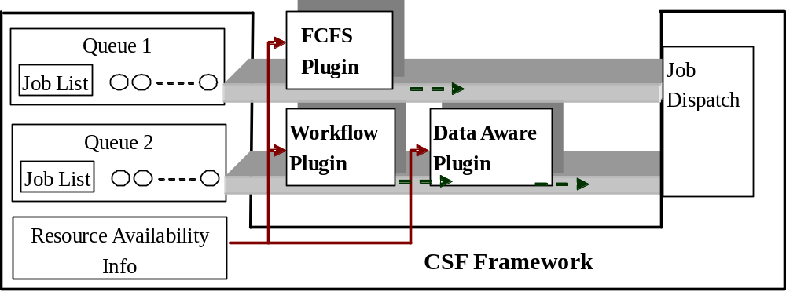
CSF4 Plugin Mechanism
CSF4 Plug-in Architecture

Slide 10
Summary
Two open source software that are indispensable for distributed data analysis
  Gfarm v2 distributed file system
    http://sourceforge.net/projects/gfarm/
  CSF4 metascheduler
    http://sourceforge.net/projects/gcsf/
Workflow and data-aware plugins enables integration and efficient use
Further integration including automatic file replica creation is considered

